Slide 1


Space-X Falcon 9 Landing Analysis
James Ogbu
16 - August - 2022

Slide 2

Outline
Executive Summary
Introduction
Methodology
Results
Conclusion
Appendix

Slide 3
Executive Summary
Summary of methodologies
Data Collection
Data Wrangling
Exploratory Data Analysis
Interactive Visual Analytics
Predictive analysis and classification
Summary of all results
Exploratory Data Analysis results
Geospatial analytics
Interactive visualization
Predictive analysis classification models

Slide 4
Introduction
The cost of launching a Space-X Falcon 9 rocket is around $62m which is considerably cheaper compared to other providers which usually cost around $165m. Most of the savings made by Space-X is because of its landing capability of the first stage of the rocket which can be reused.
If the first stage of the rocket landing successfully can be predicted it would help to assess the cost of launch or if an alternative company should make a bid.
The project is to predict if the first stage of the falcon 9 would land successfully or not.

Slide 5

Section 1

Slide 6
Methodology
Executive Summary
Data collection methodology:
Space-X API using GET requests
Data Wrangling
Data Wrangling
Removed all NaN values
Determined:
Number of launches each site
Number of occurrence of each orbit
Number of occurrence per orbit type
Creating landing outcome labels
Exploratory data analysis (EDA) using visualization and SQL
Interactive visual analytics
Geospatial analytics using Folium
Creating interactive dashboard
Predictive analysis using classification models
Preprocessing(standardize) the data
Split the data into training and testing data
Train different classification models
Finding hyperparameters using GridSearchCV
Plot confusion matrices for each model
The accuracy of the classification

Slide 7
Data Collection
The data collected for the analysis was gotten using two different methods one of which is the use of API requests from space-x public API and web scrapping of the data from a table in space-x Wikipedia entry.
Space-x columns: FlightNumber, Date, BoosterVersion, PayloadMass, Orbit, LaunchSite, outcome, Flights, GridFins, Reused, Legs, LandingPad, Block, ReusedCount, Serial, Logiitude, Latitiude.

Slide 8
Data Collection – SpaceX API
Make a GET request to Space-X API
Convert the response to JSON file and normalize the data
Define the list of data to be stored
Put list as values in a Dictionary
Create DataFrame with pandas
Reset FlightNumber column and replace missing values of Payload with mean values
Filter the DataFrame to include only Falcon 9 launches
Create DataFrame with pandas
Github link:

Slide 9
Data Collection - Scraping
Request HTML page from Wikipedia URL and assign the response to an object
Create BeautifulSoup object and find all tables within the HTML
Find and collect column header names
Iterate through table to extract data
Cast dictionary to DataFrame
Create dictionaries
Github link:

Slide 10
Data Wrangling
The Space-X dataset contains several launch facilities gotten from the “LaunchSite” columns it includes:
CCAFS SLC 40
ESC LC 39A
VAFB SLC 4E
Each launch are made to an orbit which can be found in the “Orbit” column which includes:
GTO
ISS
VLEO
PO
LEO
SSO
MEO
ES-L1
GEO
SO
HEO
Used .value_counts to determine:
Number of launches by site
Number of occurrence by orbit
Number of occurrence of landing outcome by orbit type
Create Training label for successful launches to be “1” and unsuccessful to be “0” as a new column “Class”.
Github Link:

Slide 11
EDA with Data Visualization
Exploratory Data Analysis performed on:
Flight Number
Payload Mass
Launch site
Orbit
Class
Year
CHARTS INCLUDE:
Scatter Charts to visualize relationships between
Flight Number and launch site
Payload and Launch site
Orbit type and Flight number
Payload and orbit type
Bar Chart to compare numeric value to categorical value:
Success Rate and Orbit type
Line Chart to show the change in variable with time:
Success rate and time
Github link:

Slide 12
EDA with SQL
THE SQL QUIRES PERFORMED ON THE DATA
Show the name of unique launch sites
Show 5 records where launch sites begins with “CCA”
Show the total payload mass carried by a booster launched by NASA(CRS)
Show Average payload mass by booster version F(v1.1
List the date when the first successful landing on the ground pad was achieved
List name of boosters which has success on a drone ship and a payload mass between 4000 and 6000 kg
List successful and failed mission outcomes
List the name of boosters version with the maximum payload mass
List failed landing outcome on drone ships, their booster versions and launch site for 2015
Rank the count of landing outcomes between 2010-06-04 and 2017-03-20 in descending order
Gihub link:

Slide 13
Build an Interactive Map with Folium
An interactive map was built with folium to visualize the launch data
All launch sites where marked using functions like .folium.circle and .folium.marker
Mark the successful and failed launches on each site on the map
Launches with the same coordinates where clustered together
Successful launches where assigned as green and failed as red from the “Class column”
Creating an icon and a text label
Calculate distance between launch site to its proximities
Calculating the distance between points with the lat and long values
Creating marker to show distance
Display the distance between the two point with the help of .folium.polyline to add it to the map

Slide 14
Build a Dashboard with Plotly Dash
The following plots where created with Plotly dash dashboard for an interactive visualization of the data:
Pie chart(.px.pie()) showing the total successful launches
Shows Launch site success rate with percentage
The chart could be filtered to show successful/failed launches using dcc.Dropdown
Scatter Graph(px.scatter()) to show the correlation of successful and failed launches with payload mass
It could be filtered using a .RrangeSlider() by range o payload mass
Could be filtered by booster version

Slide 15
Predictive Analysis (Classification)
Model Evaluation
Best Classification Model
Model Deployment
Load the dataset
Data transformation (standardization and preprocessing
Split data to test and train data with .train_test.split()
For each machine learning algorithm create a GridsSarchCV object
Fit object in parameters
From the chosen algorithms with GridSearchCv
Check for hyper parameters with .best_params
Check for accuracy with .score and .best_score_
Plot confusion matrix
Review all algorithms accuracy score
The model with the best performance is the best algorithm
Plot bar chart to show best performing model

Slide 16
Results
Exploratory data analysis results
Interactive analytics demo in screenshots
Predictive analysis results

Slide 17

Section 2

Slide 18
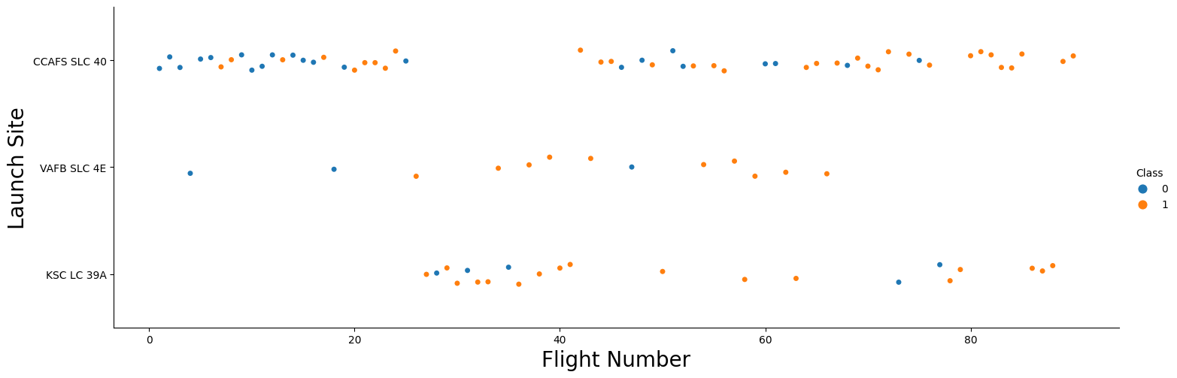
Flight Number vs. Launch Site
Most of the early flight are unsuccessful(flight numbers less than 30) from CCAFS SLC 40 Launch site
Most launches where made at the CCAFS SLC 40 launch site
As the number of flight increases the success rate increases
No early flight where in KSC LC 39A and the launches from the site are mostly successful
Early flight from the VAFB SLC 4E launch site where unsuccessful
All flight from the flight number 80 where successful

Slide 19
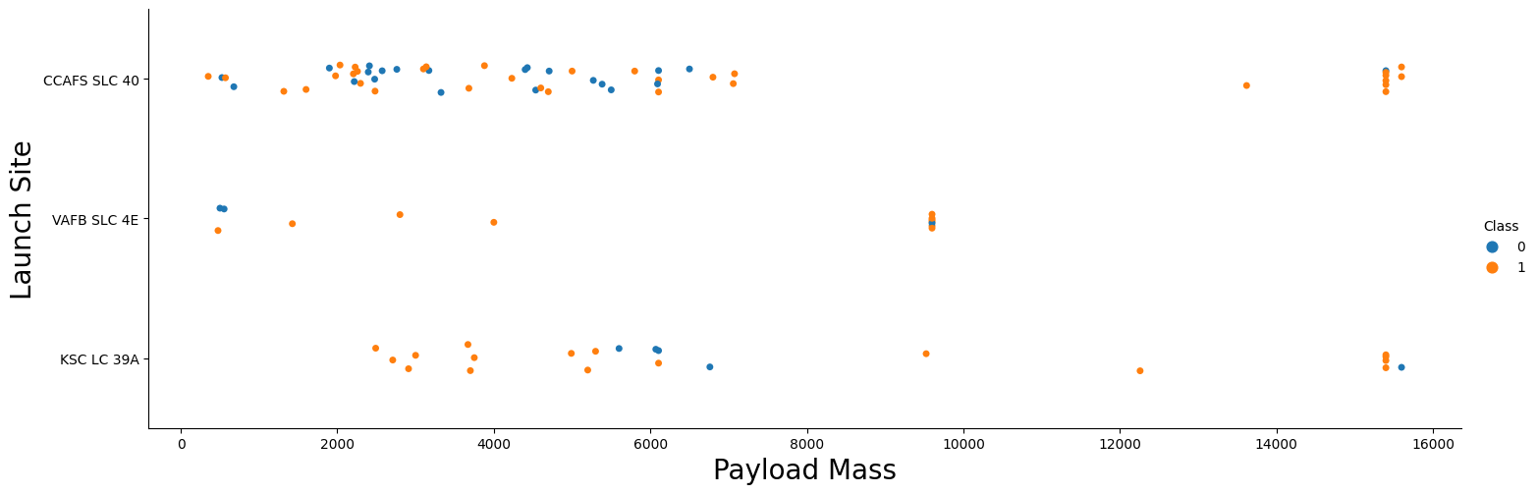
Payload vs. Launch Site
Payload mass above 7000 kg has few unsuccessful landing but fewer launches of that nature where made
There is no correlation of payload mass and success rate
All launch site carries variety of payload masses

Slide 20
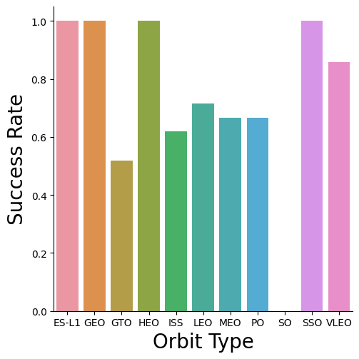
Success Rate vs. Orbit Type
The following Orbit has a success rate of 100%
ES-L1 (Earth-sun first Lagrangian point)
GEO (Geostationary Orbit)
HEO (High Earth Orbit)
SSO ( Sun synchronous Orbit)
The orbit with the lowest (0%) success rate is
SO (Heliocentric Orbit)

Slide 21
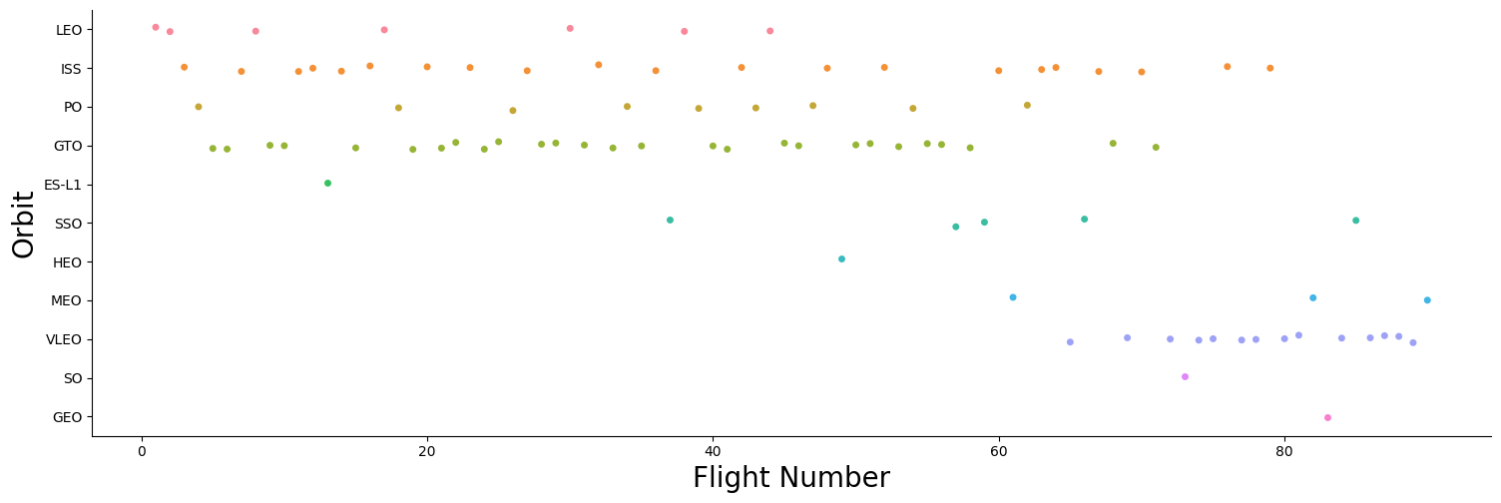
Flight Number vs. Orbit Type
Most flight where to the ISS and GEO orbit
Early flight where taken to the LEO, ISS, PO and GEO orbit

Slide 22
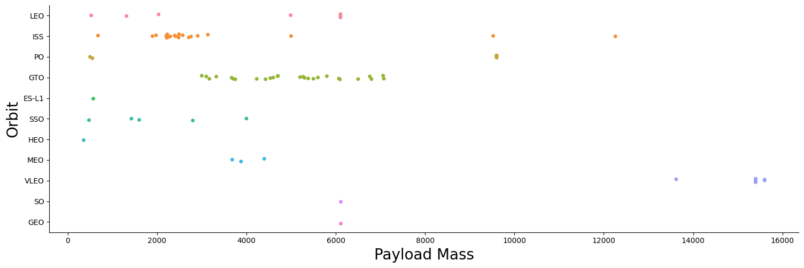
Payload vs. Orbit Type
Most heavy payload of 10000 kg and above where being launched to VLEO orbit
LEO and SSO seems to have low payload mass compared to the other orbit type

Slide 23
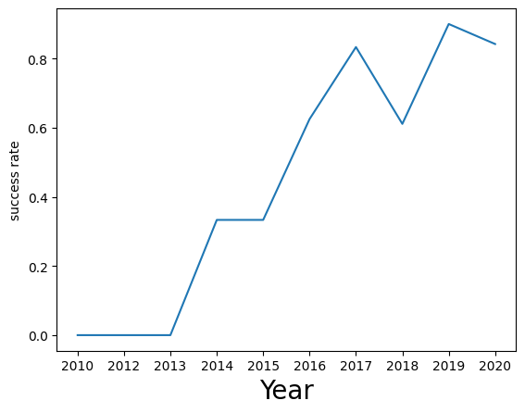
Launch Success Yearly Trend
The success rate of launches has generally increased over the years with a dip in 2018
There was 0% success rate from 2010 to 2013
Current success rate of launches is at 80% as of year 2020

Slide 24
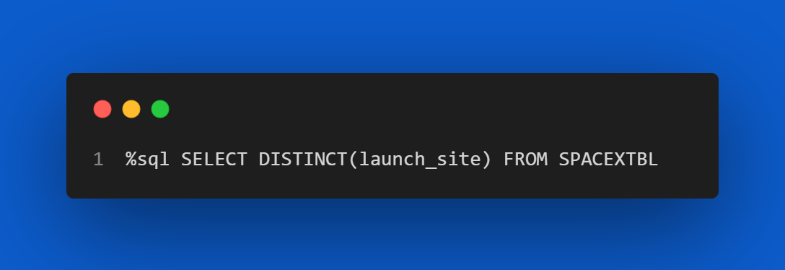
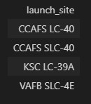
All Launch Site Names
Find the names of the unique launch sites

Slide 25
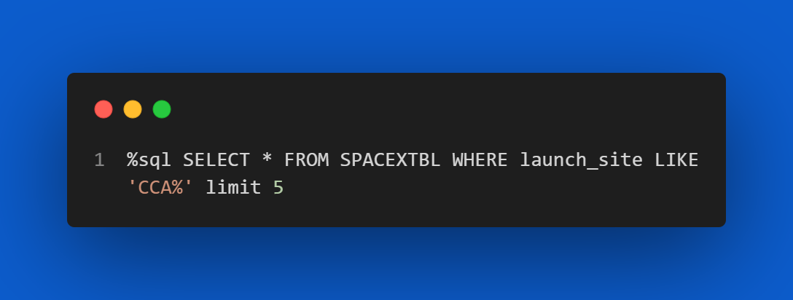
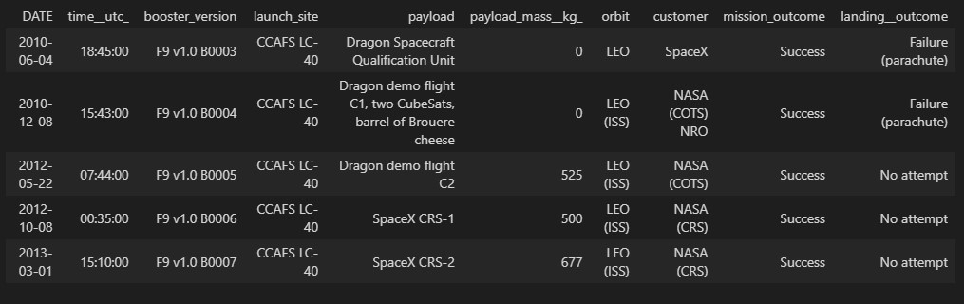
Launch Site Names Begin with 'CCA'
Find 5 records where launch sites begin with `CCA`

Slide 26
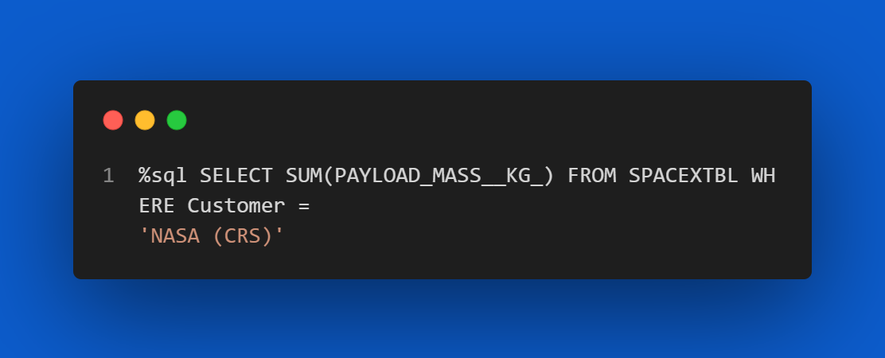
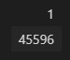
Total Payload Mass
Calculate the total payload carried by boosters from NASA

Slide 27
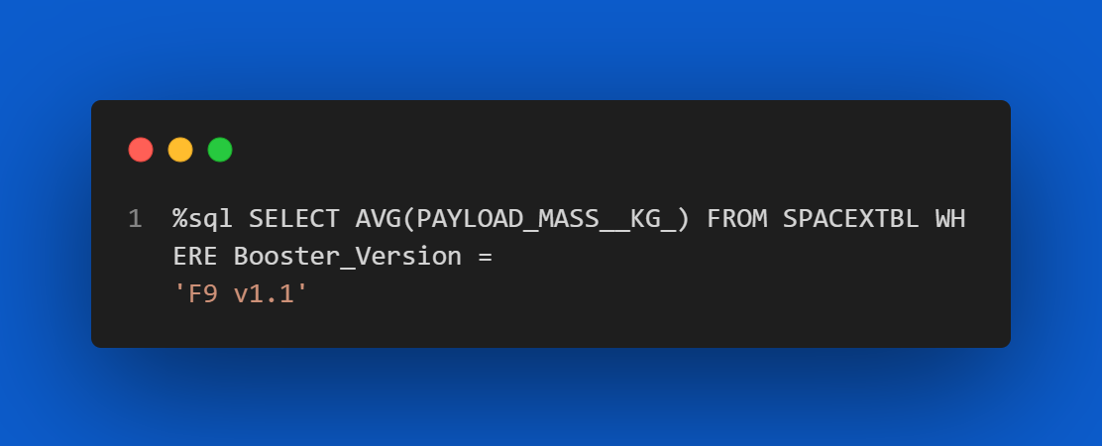
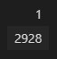
Average Payload Mass by F9 v1.1
Calculate the average payload mass carried by booster version F9 v1.1

Slide 28
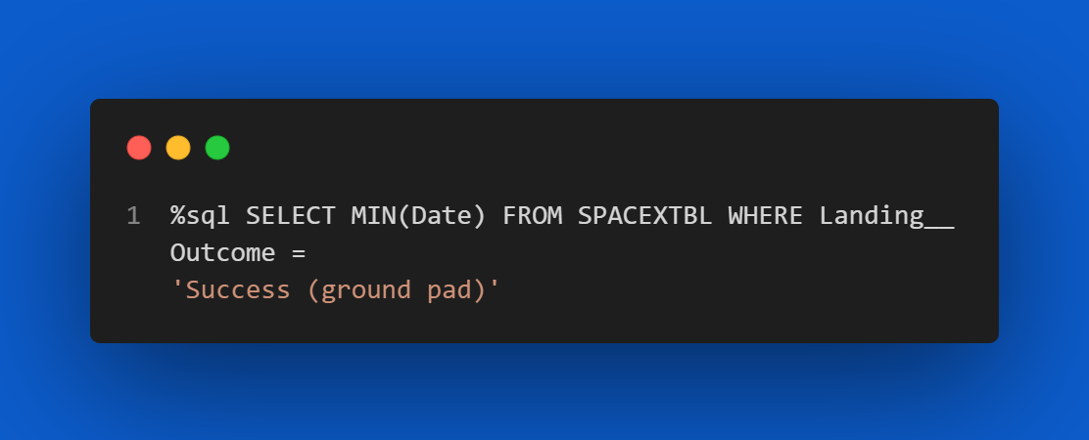

First Successful Ground Landing Date
Find the dates of the first successful landing outcome on ground pad

Slide 29
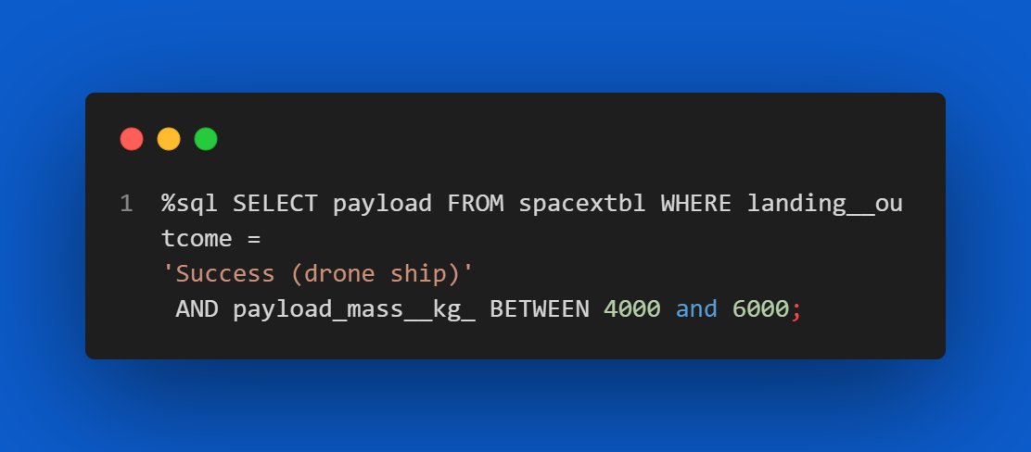
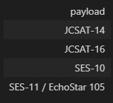
Successful Drone Ship Landing with Payload between 4000 and 6000
List the names of boosters which have successfully landed on drone ship and had payload mass greater than 4000 but less than 6000

Slide 30
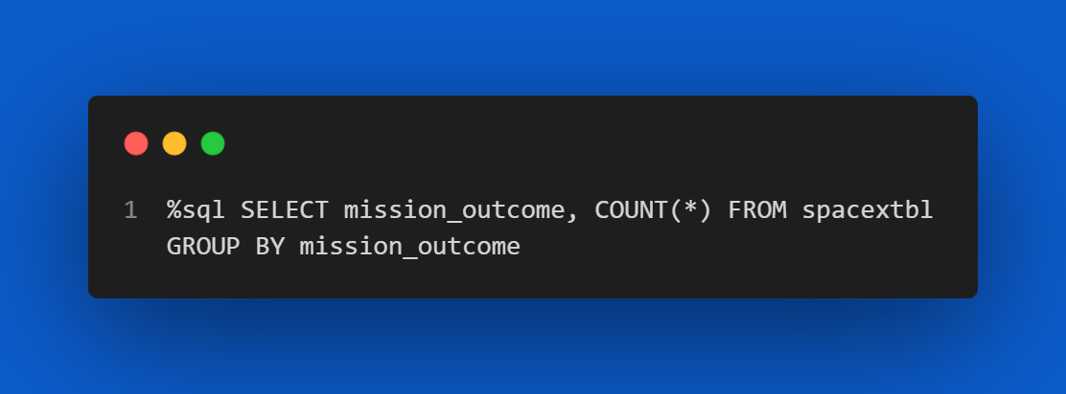
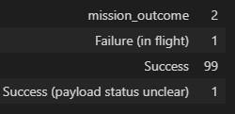
Total Number of Successful and Failure Mission Outcomes
Calculate the total number of successful and failure mission outcomes

Slide 31
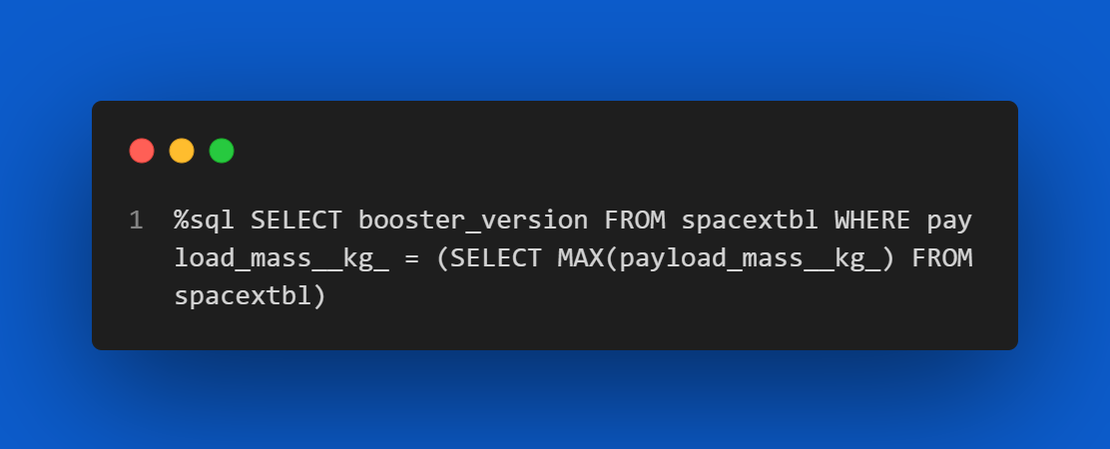
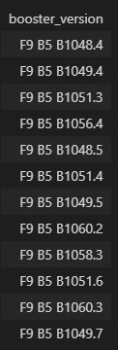
Boosters Carried Maximum Payload
List the names of the booster which have carried the maximum payload mass

Slide 32
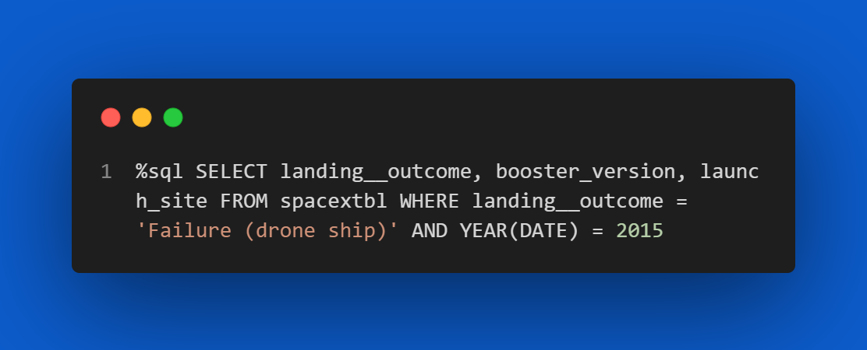
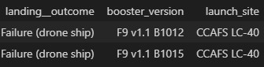
2015 Launch Records
List the failed landing outcomes in drone ship, their booster versions, and launch site names for in year 2015

Slide 33
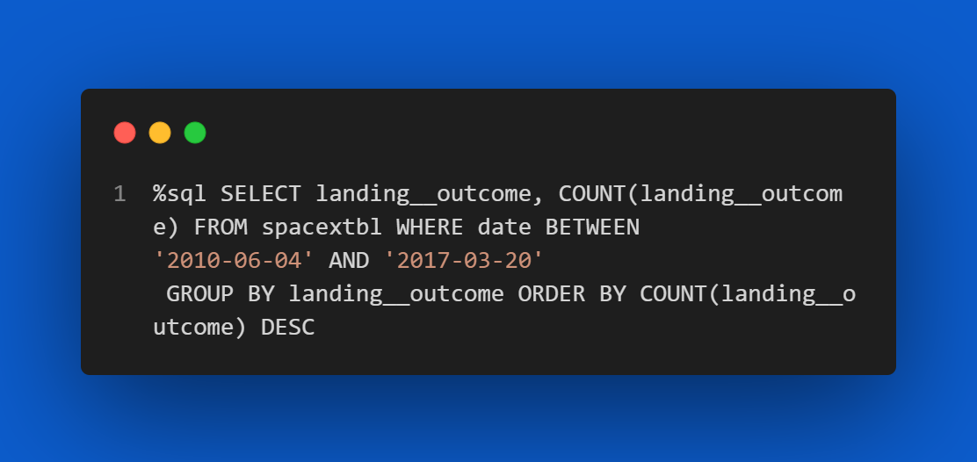
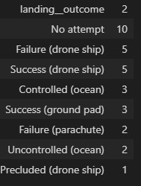
Rank Landing Outcomes Between 2010-06-04 and 2017-03-20
Rank the count of landing outcomes (such as Failure (drone ship) or Success (ground pad)) between the date 2010-06-04 and 2017-03-20, in descending order

Slide 34

Section 3

Slide 35
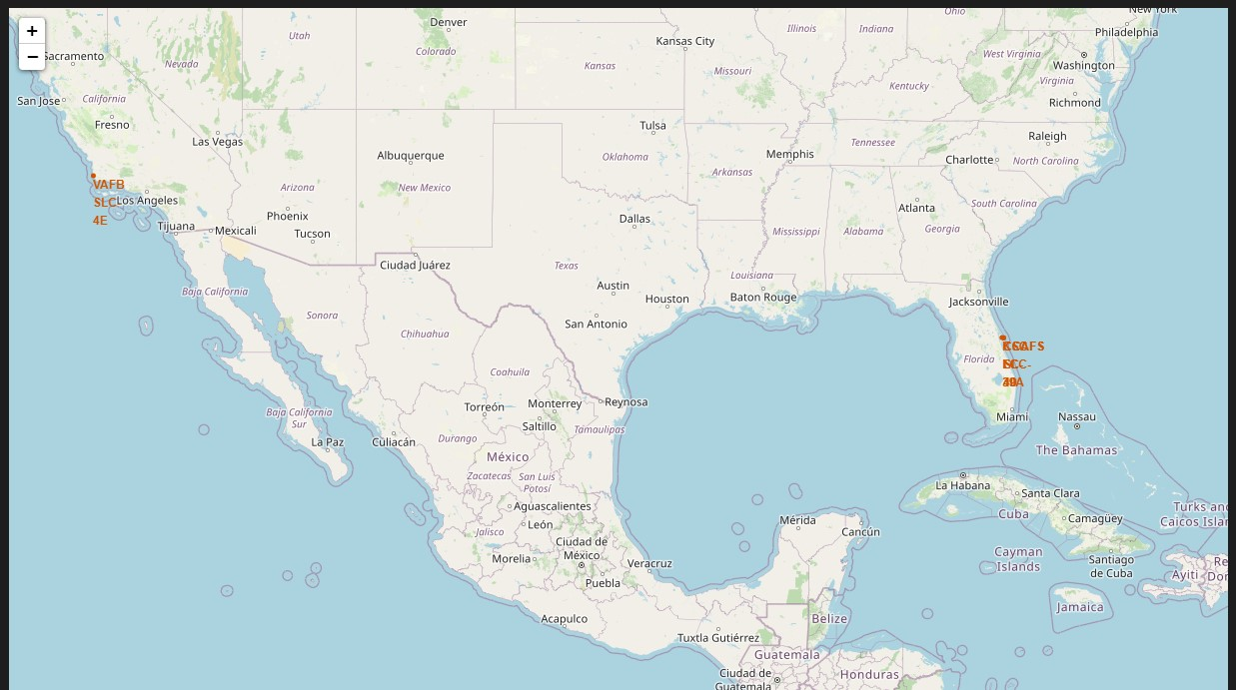
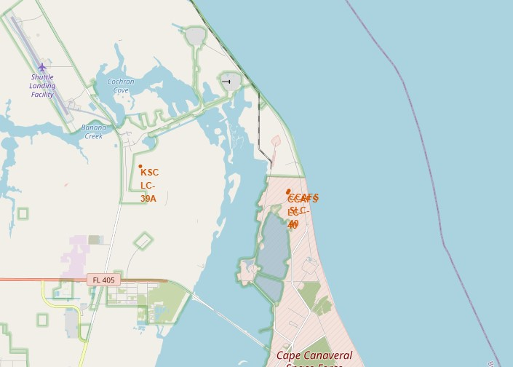
ALL LAUNCH SITES ON MAP
All space-x launches are located at the coats of united states of America in Florida and California

Slide 36
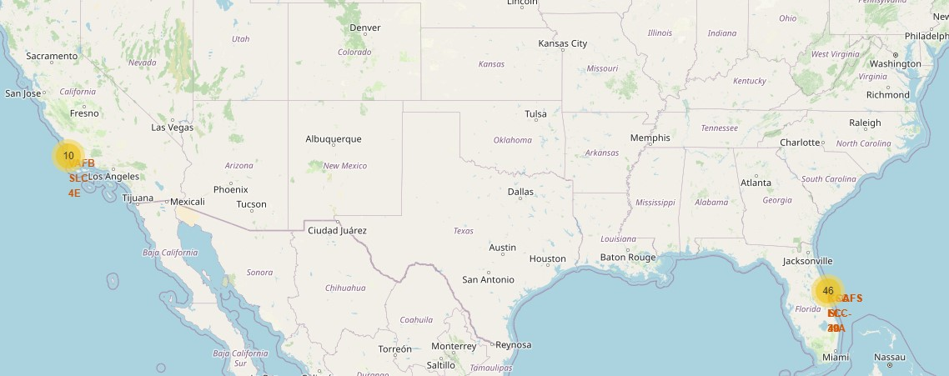
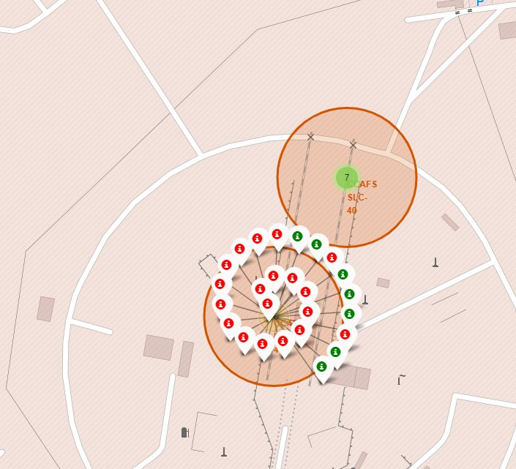
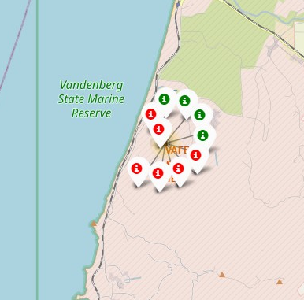
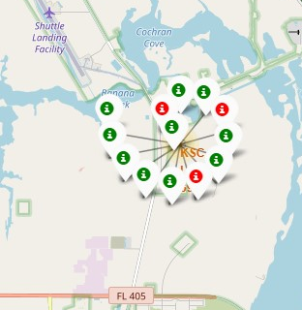
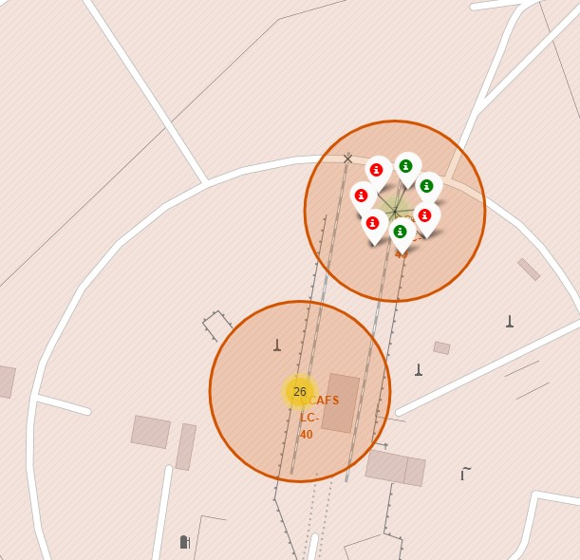
SUCCESSFUL AND FAILED LAUNCHES FOR EACH SITE
CCAFS LC-40
Launches has been grouped
Green icons for successful launches
Red for failed launches
VAFB SLC-4E
KSC LC-
CCAFS SLC-40

Slide 37
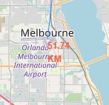
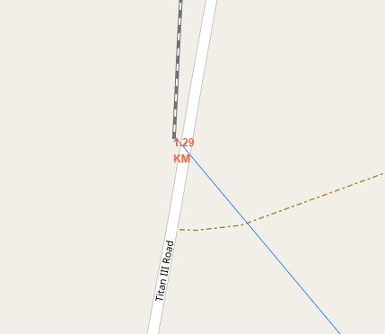
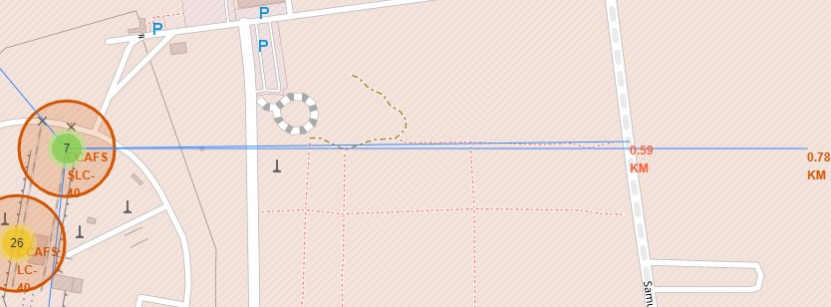
PROXIMITY OF LAUNCH SITES TO OTHER POINTS OF INTEREST
CCAFS SLC-40 launch site as example site to understand placement of launch sites
The coastline is about 0.78km from coastline
The nearest highway is about 0.59km from the site
The nearest railway is about 1.29km away
The nearest city is about 51.7km away

Slide 38

Section 4

Slide 39
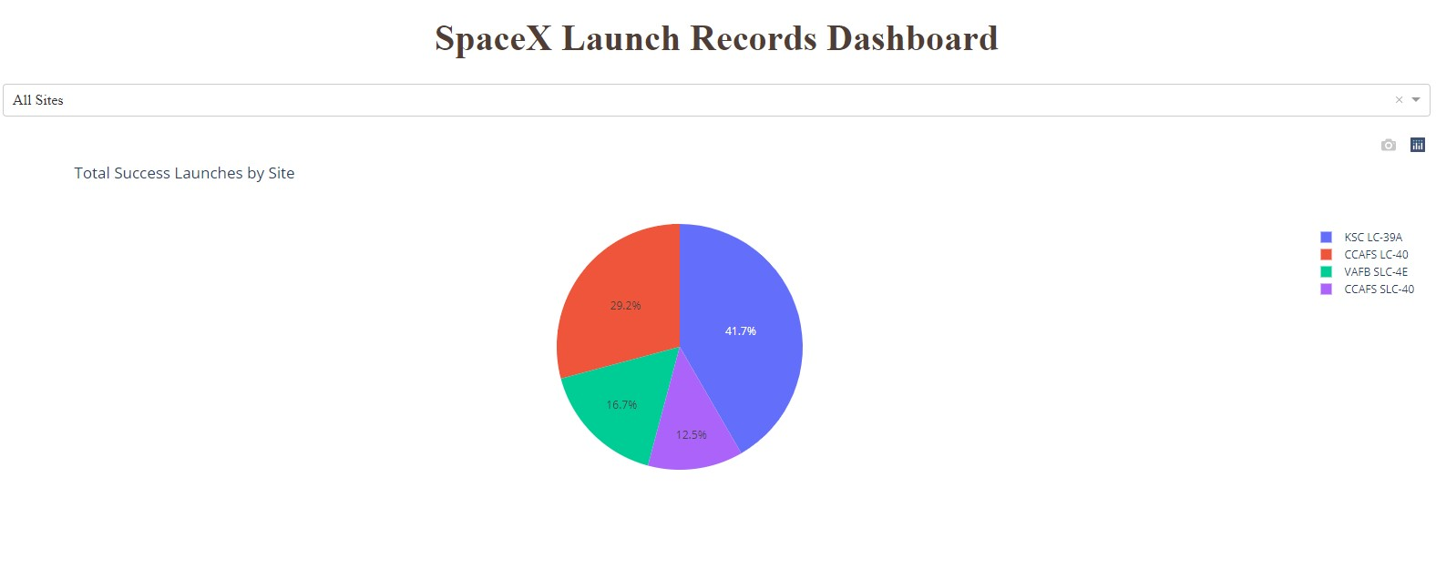
LAUNCH SUCCESS RATE OF ALL SITE
Launch site KSC LC-39A has the highest success rate of a 41.7%

Slide 40
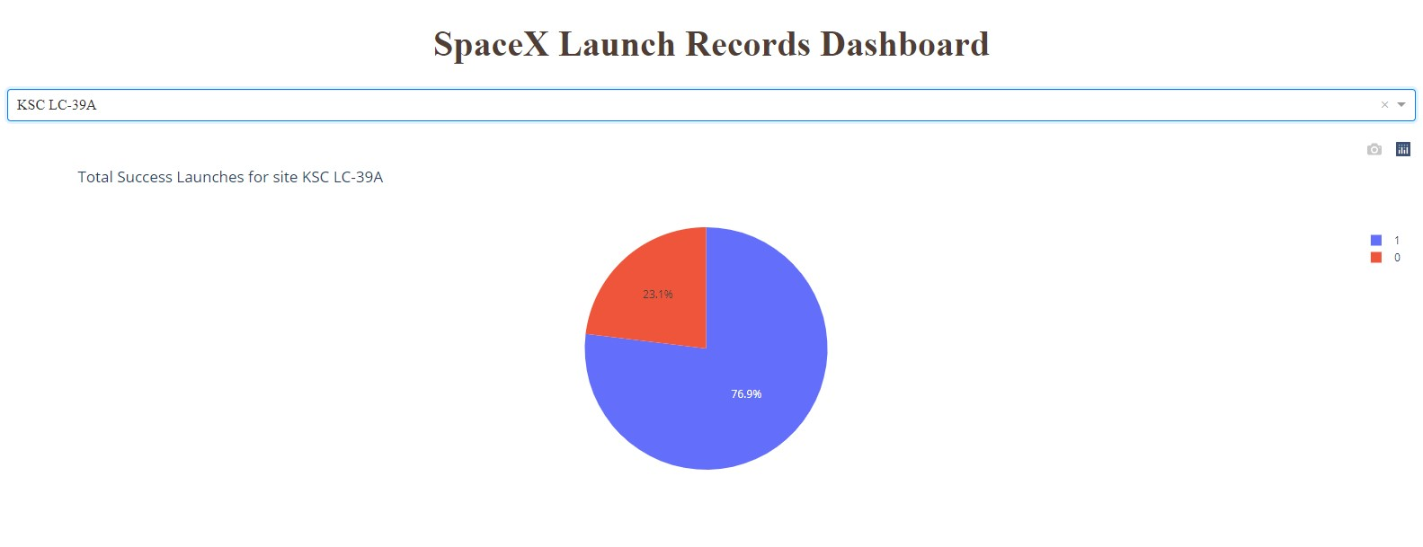
LAUNCH SITE WITH THE HIGHEST SUCCESS RATE PIE CHART
The launch site KSC LC-39A has a success rate of 76.9% and failed launches of 23.1%.

Slide 41
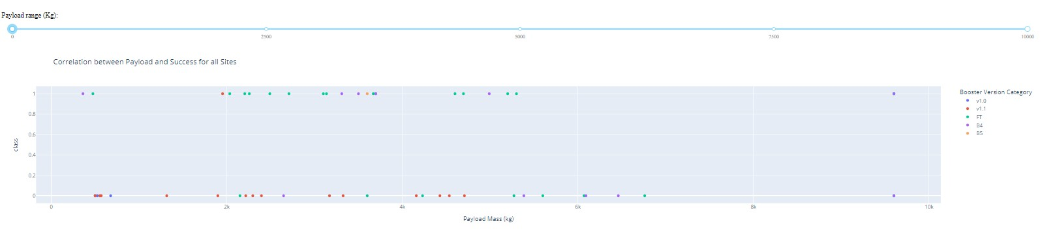
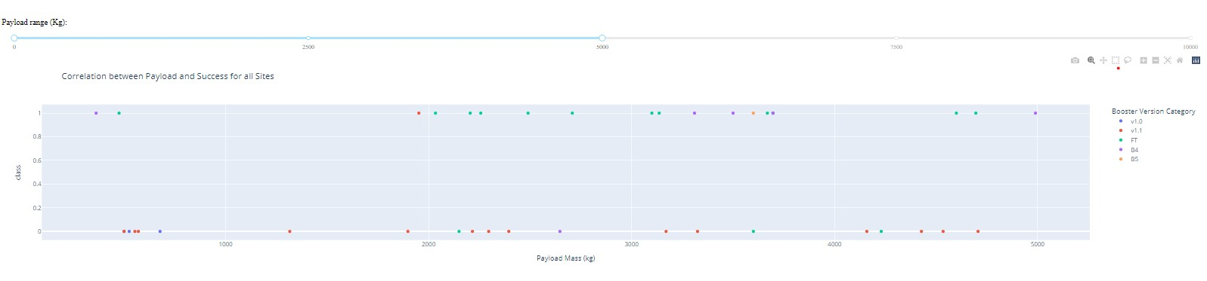
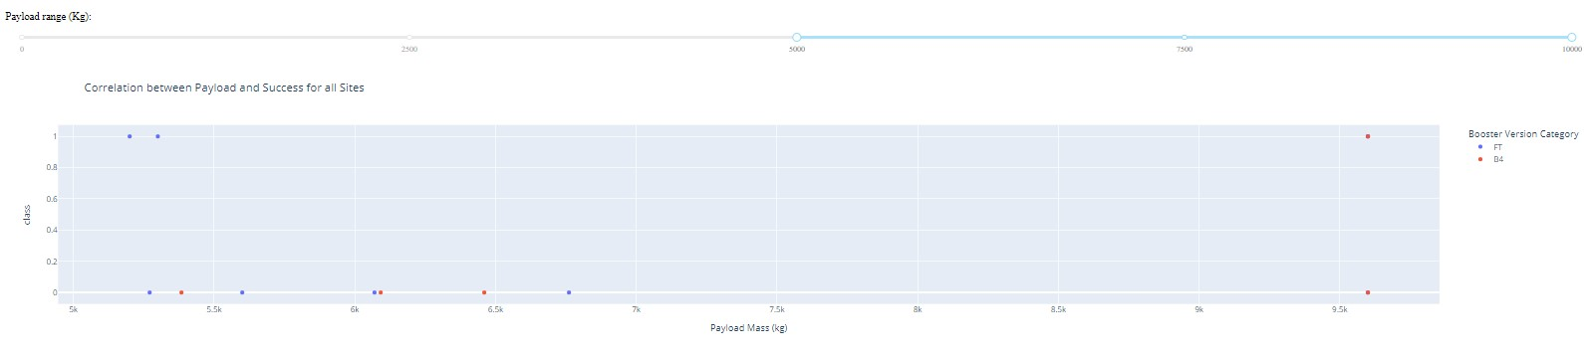
PAYLOAD VS. LAUNCH OUTCOME SCATTER PLOT FOR ALL SITES
The launch site is split into two 0-5000(Low payload) and 5000-1000(high payload load)
They are more successful launches in sites with low payload
Booster types v1.0 and B5 are not used to launch heavy payload
1/2
Low payload
1
High payload
2

Slide 42

Section 5

Slide 43
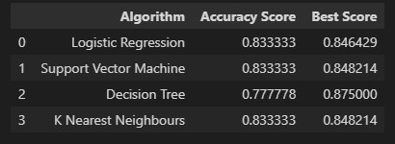
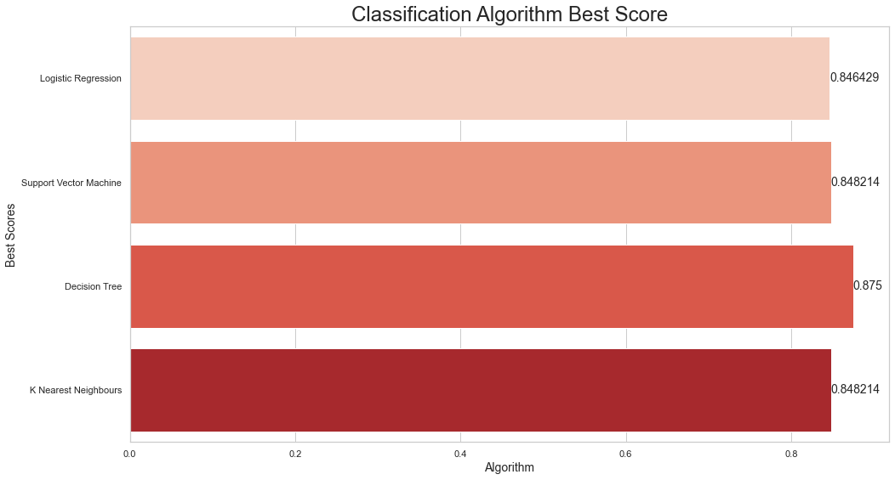
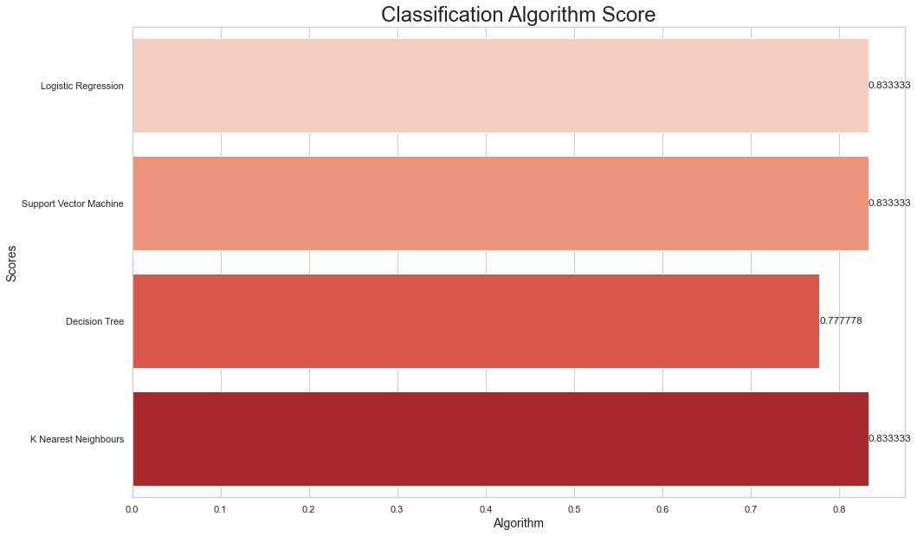
Classification Accuracy
All models has virtually the same accuracy
Decision tree having the highest .best_score at 87%
K- Nearest Neighbor, SVM and Logistic regression having the highest .score at 83.3%

Slide 44
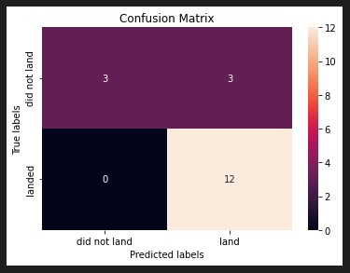
Confusion Matrix
All models predicted the same outcome
Out of all the result 3 was a false positive which is an incorrect prediction
The remaining 15 where classified correctly

Slide 45
Conclusions
Most early launches where unsuccessful but as the number of launches increases the launch success rate increases.
From 2010 to 2013 they was no successful launch
From 2013 the success rate increased with a dip in the year 2018
By the year 2020 the success rate was at 80%
The following orbit type has a 100% success rate ES-L1, GEO, HEO, and SSO
GEO, HEO and ES-L1 orbits has only 1 successful flight which explains the 100% success rate in this orbits
SSO is more impressive with 5 successful flights
VLEO(very low earth orbit) is associated with heavy payload
The launch site with the most successful launches is the KSC LC-39A with a success rate of 76.9% with a total success rate of 41.7% of all sites
Launches with lower payload of <5000kg are more successful than heavy payloads
The best model used is the descision tree with .best_score_ of 87.5%

Slide 46
Appendix
Githhub link to project:
Github link to data collection with API:
Github link to data collection with web scraping:
Success rate over the years
Orbit type success rate
Model algorithm accuracy score and best score

Slide 47


